Slide 1
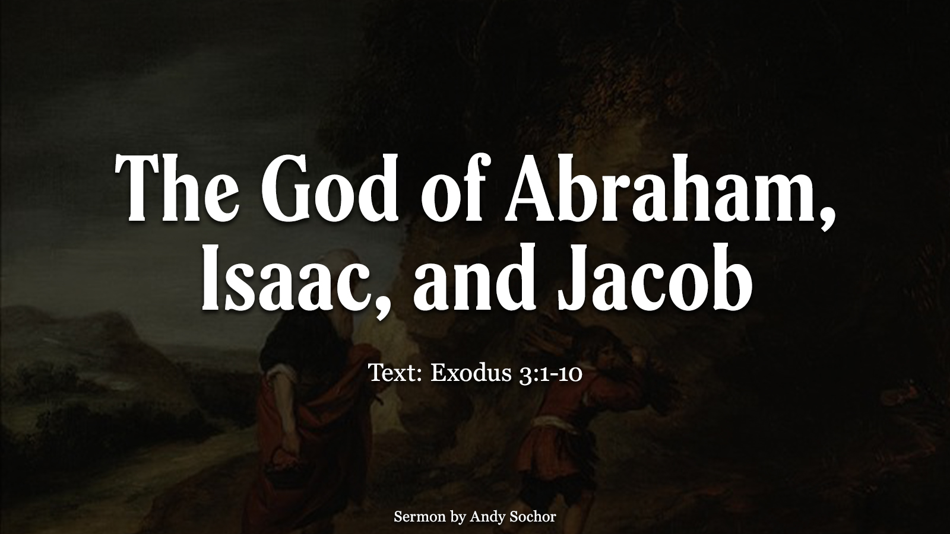

Slide 2
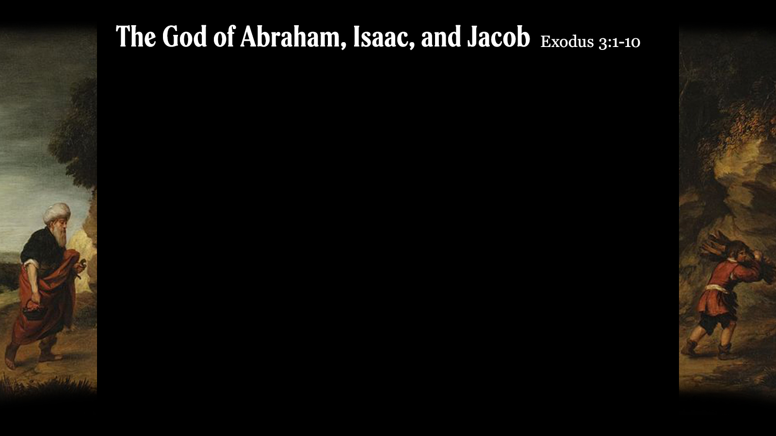
God’s Appearance to Moses
God appeared to Moses in the burning bush – identified Himself as the God of Abraham, Isaac, and Jacob (the “patriarchs”)
Abraham – father of the faithful (Rom. 4:11-12, 16)
Isaac – son of promise (Gen. 18:10; Rom. 9:9)
Jacob – father of the nation of Israel (Gen. 46:27; Deut. 10:22; 26:5)
God was sending Moses to deliver His people from Egypt – He saw their suffering (Ex. 2:23-25; 3:7), and was going to deliver them because of His promise to Abraham, Isaac, and Jacob
God would prove that He keeps His promises, no matter how unlikely it seemed (Ex. 3:8)

Slide 3
God’s Promise to Abraham
The promise was threefold (Gen. 12:1-3; 22:16-18)
Nation – his descendants would grow to be a powerful nation
Land – they would receive the land of Canaan (Gen. 17:8)
Seed – would bless all nations; pointed to Christ (Acts 3:25)
The promise continued to the next generations – to Isaac (Gen. 26:1-5); to Jacob (Gen. 28:13-15; 35:9-12)
The promise was not dependent upon man’s help (Gen. 15:1-4; 16:1-4; 17:15-19; 22:1-3, 10-12)

Slide 4
Abraham’s Response of Faith
He believed God and it was counted to him as righteousness (Rom. 4:3) – “credited” (NASB); accounted by God
He believed even though it was contrary to human reasoning (Rom. 4:17-22) – “in hope against hope”; his body was “as good as dead” and Sarah’s womb was “dead”
His faith led to obedience (James 2:21-24) – he was willing to offer Isaac; he reasoned that God could raise him from the dead (Heb. 11:17-19)

Slide 5
The Promise for Us
We are justified by faith, just like Abraham (Rom. 4:22-5:1) – we believe in God, believe that Jesus was raised from the dead, and that He died for our sins
We can be heirs of the same promise (Gal. 3:26-29) – we have this promise if we belong to Christ (through faith; baptized into Christ)
We have hope because of who God is (Ex. 3:14) – Jesus used this to prove the reality of the resurrection (Mt. 22:31-32); we have “strong encouragement” to take hold of this hope (Heb. 6:13-20)

